Slide 1
A Medical Information Management System
Based on Blockchain
Group Members
Tang Xinzhe
Wu Yuhan
Shi Xinyi

Slide 2
CONTENT
01
Background & Innovation
02
Technical Basis
03
System Design
04
Blockchain Network Construction
05
System Interface & Operation
06
Conclusion

Slide 3
Background &
Innovation
1

Slide 4
Blockchain
Distributed Ledger Technology（DLT）
Decentralized, Tamper resistance, Traceability……
Background
Internet Medical
Health Education
Medical Information Inquiry
Electronic Health Records
Electronic Prescriptions
Disease Risk Assessment
Online Medical Treatment
Remote Consultation
Remote Rehabilitation
……

Slide 5
Blockchain + Internet Medical
Use blockchain to integrate medical data
Blockchain-based secure storage access scheme for medical records
Pharmaceutical anti-counterfeiting traceability system
Background
Medical Information Island
Data asymmetry and redundancy
Difficult to share and use
Medical Information Supervision
User's privacy
Insurance reimbursement
Electronic prescription review
Secure storage of electronic medical records
Notes:
利用区块链对医疗数据资源进行整合，促进医疗数据的共享流动
基于区块链的医疗记录安全存储访问方案
医药防伪溯源系统
数据的不对称和冗余
难以共享和使用
用户的隐私权
医保报销、电子处方审核、电子病历的安全存储

Slide 6
Expand Participation In the System
Improve Shareability
Develope Smart Contract
Involves different medical information application scenarios
Innovation
Build a blockchain network based on the hyperledger of the alliance chain
Generate and store medical information
Reduce the cost of information management
Ensure the efficiency of verifying the authenticity of information
Notes:
涉及到不同的医疗信息应用场景
基于联盟链的超级账本
能够生成和存储医疗信息

Slide 7
2
Technical Basis

Slide 8
· Smart Contract
· Hyperledger Fabric
· Transaction
Provide automatic services
Make the contract execution process highly transparent and immutable
Blockchain
Open source distributed ledger platform for enterprise applications
A multi-ledger design is adopted to distinguish it from the public chain
Write transaction information to the blockchain
Enable the building and running of trusted distributed applications
Notes:
提供了自动执行的服务，实现了传统合约的自动化处理
使合约执行流程高度透明且无法篡改
面向企业级应用的开源分布式账本平台
采用多账本的设计方式以区别于公有链
处理和验证交易
将交易信息写入区块链

Slide 9
3
System Design

Slide 10
System design goals
Ledger generation
Privacy protection
Provide
inquiry
Users from all parties in the system maintain the same distributed ledger that records various medical information.
Assign different operation permissions to different user roles.
Provide a stable and efficient query interface to support users such as doctors and insurance companies in querying medical information.

Slide 11
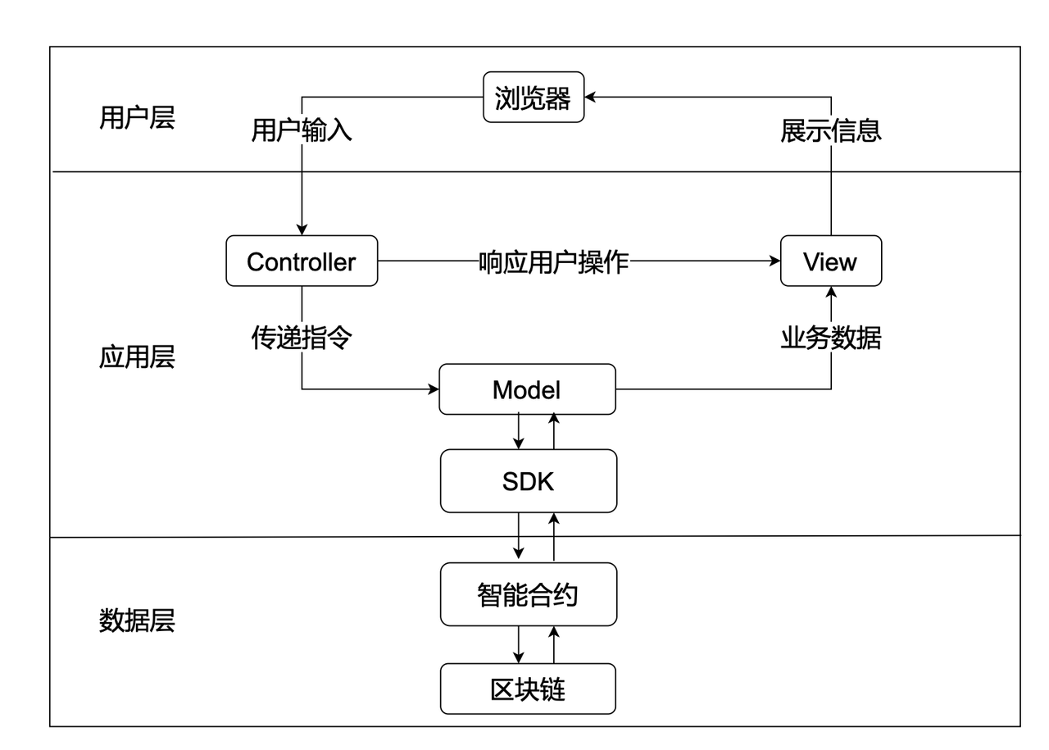
Hyperledger Fabric
System technical architecture diagram

Slide 12
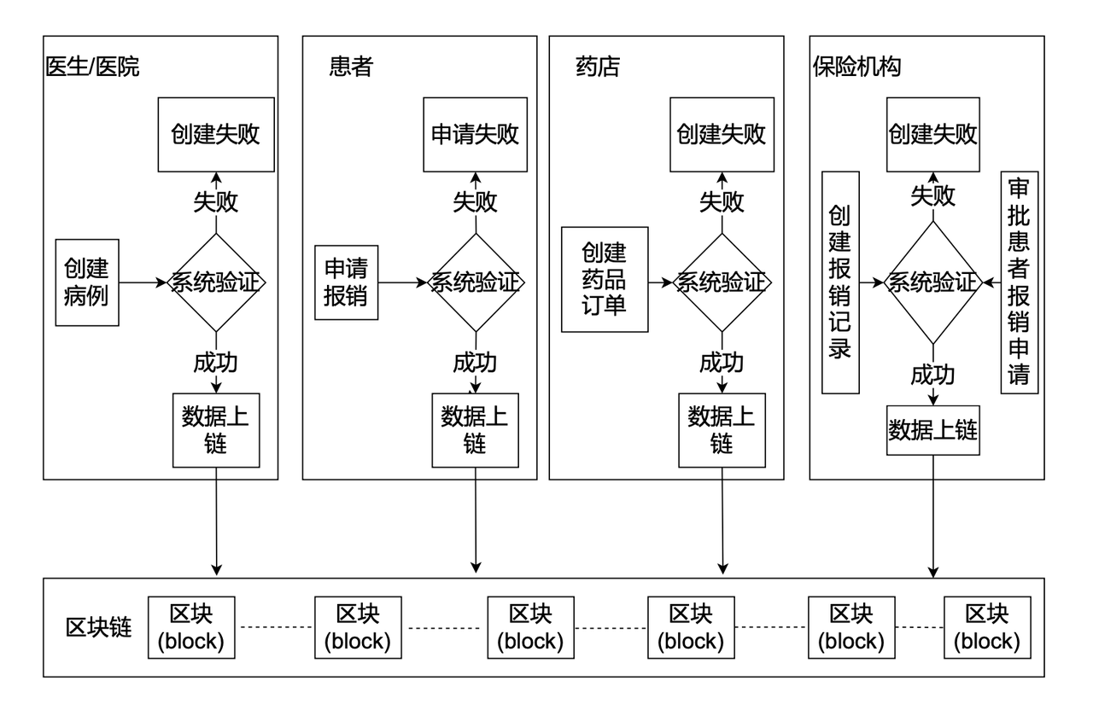
Hyperledger Fabric
System business flow chart

Slide 13
4
Blockchain Network
Construction

Slide 14
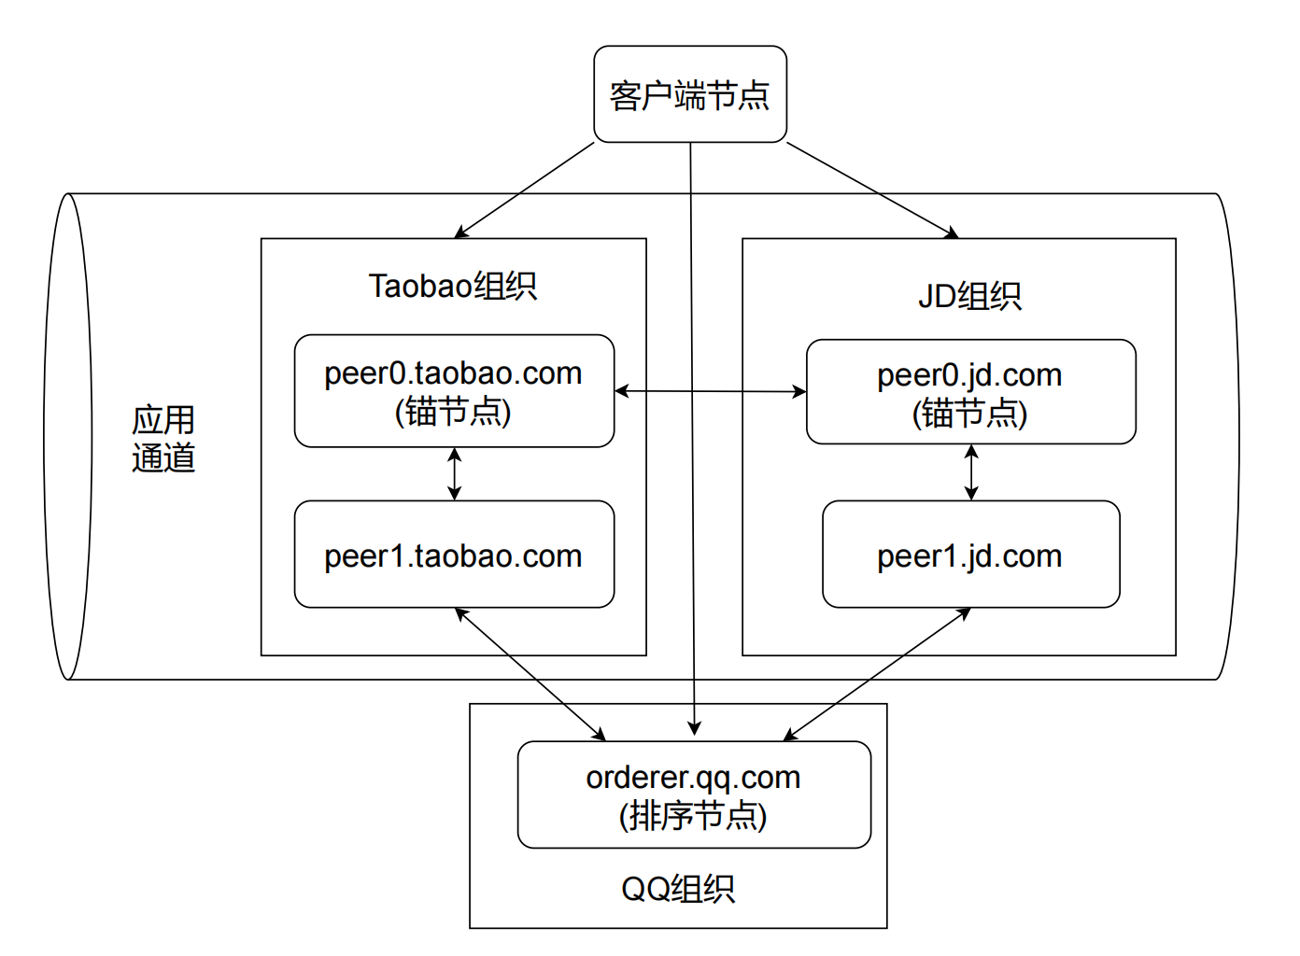
Blockchain network topology diagram

Slide 15
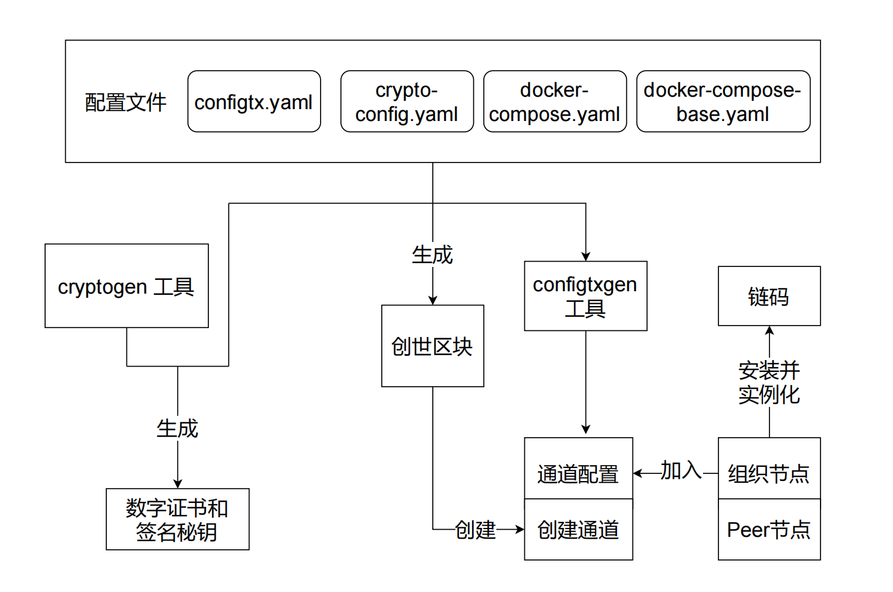
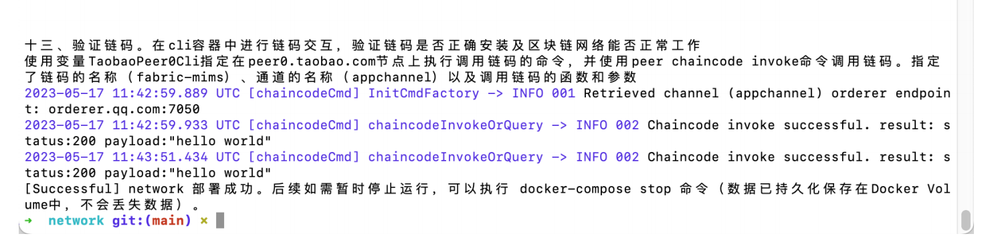
Network construction process
Configuration files
Certificate files
Genesis block
Channel configurations
Contract deployment
Network setup completed

Slide 16
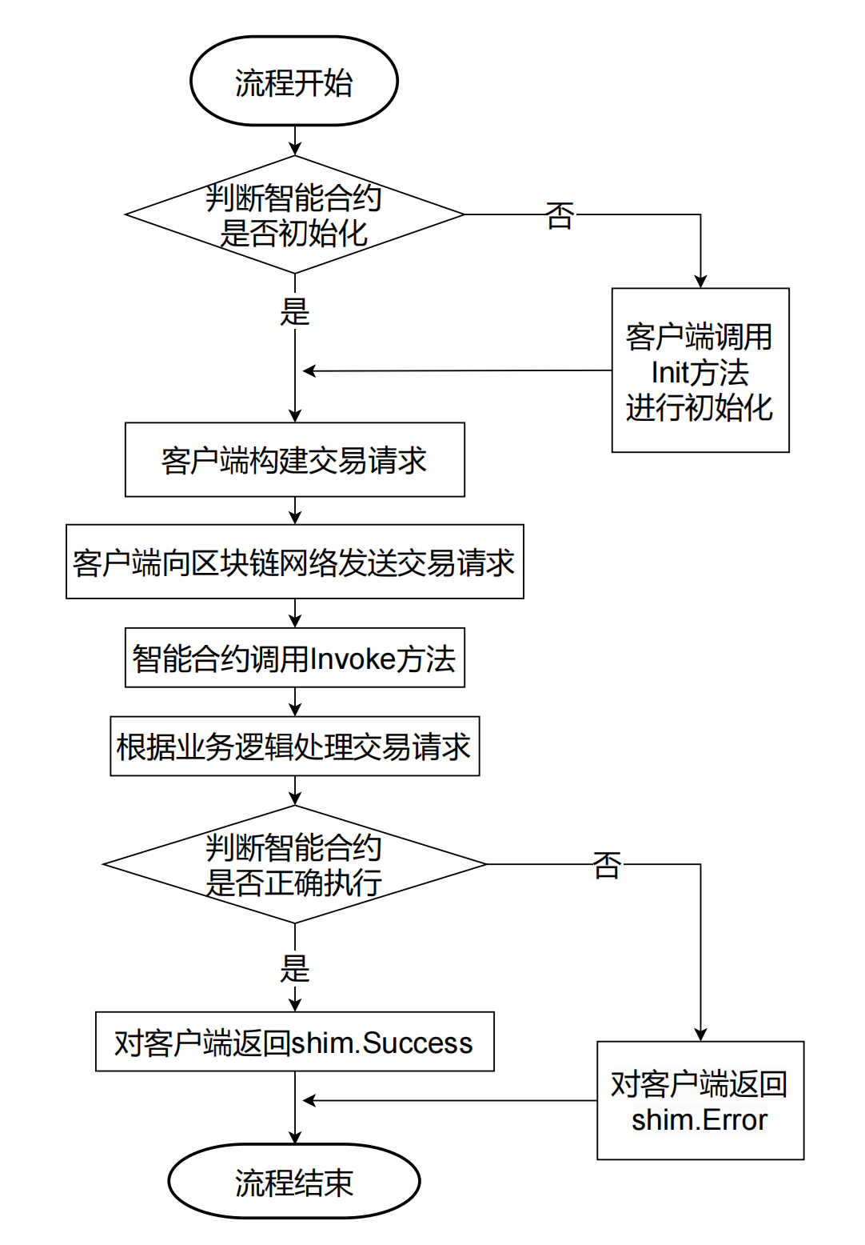
Read Data
GetState
Chaincode Interface
Smart contract calls
Write Data
PutState

Slide 17
5
System Interface & Operation

Slide 18
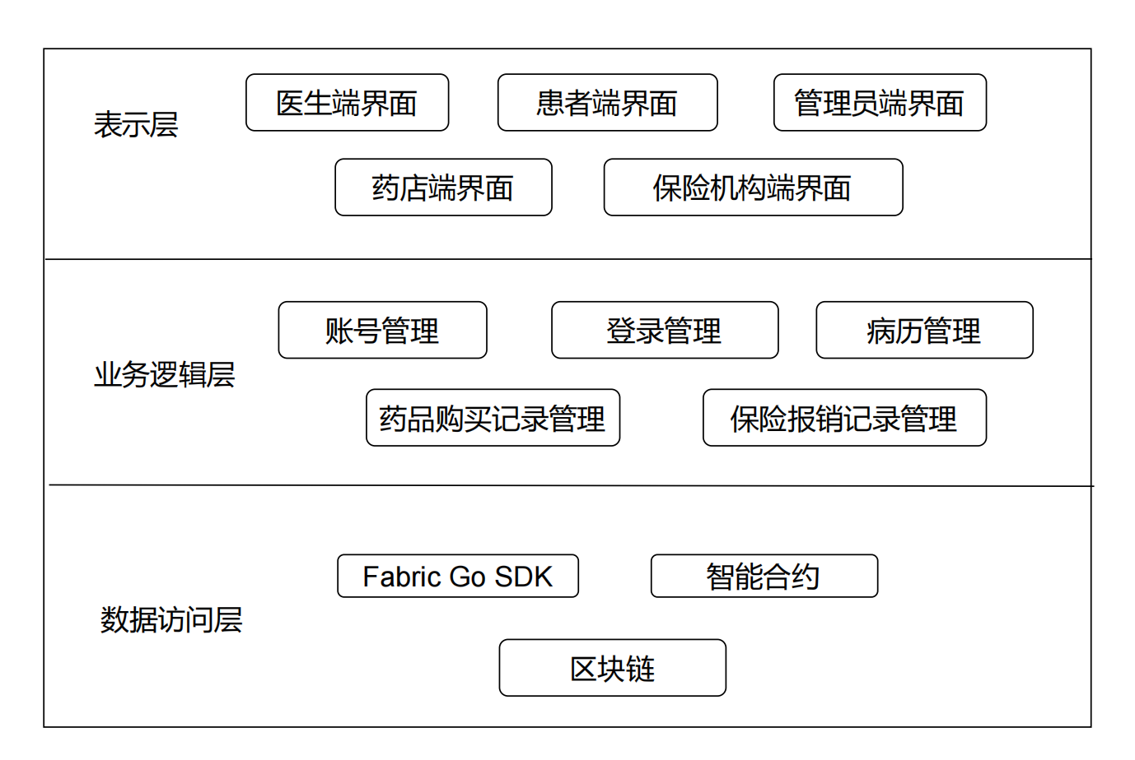
functional module

Slide 19
System homepage http://20.2.241.133:9528/
Blockchain Browser http://20.2.241.133:8080/#/
User name: admin
Password: 123456

Slide 20
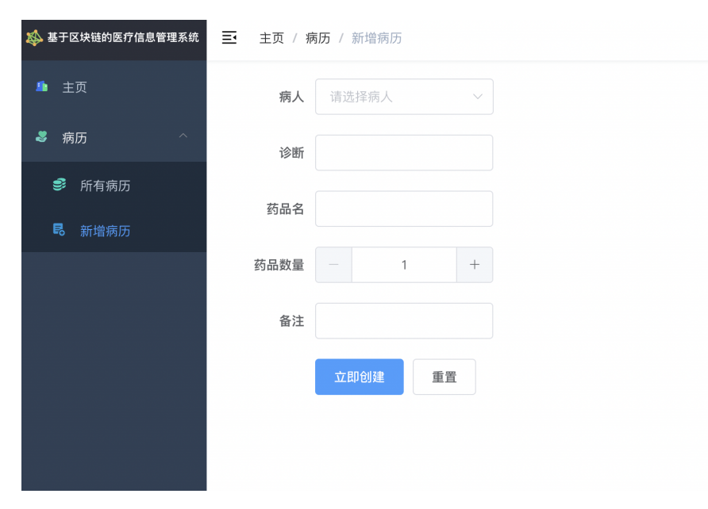
Doctor
Doctor creates medical records
Query patient basic information
Fill in medical record information
Front end calling backend interface
Verify the correctness of role permissions and content
On chain storage of data
Calling the CreatPrescription() function
Calling the putstate() function to store the blockchain and change the world state

Slide 21
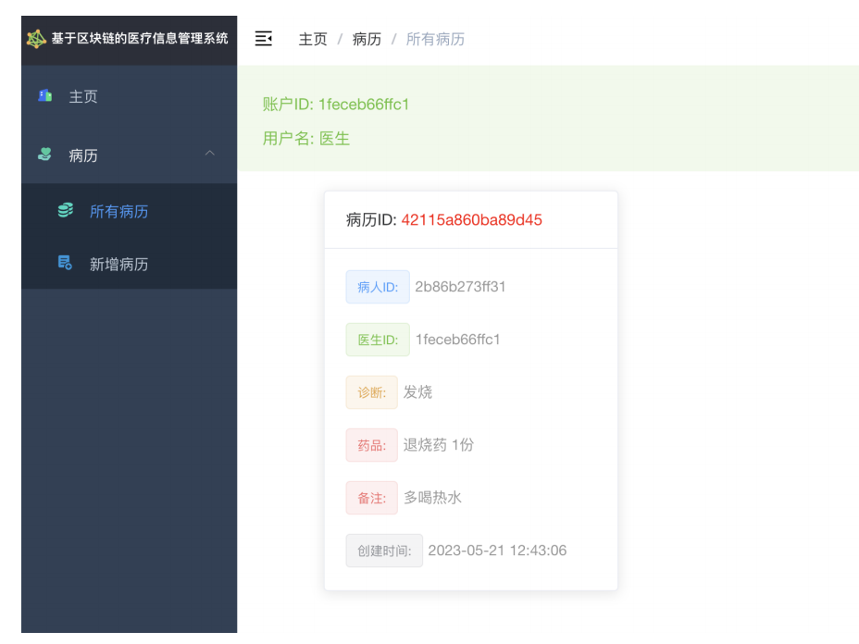
Doctor
Doctors view medical records
View medical records based on the doctor's information and permissions
On chain query information
Calling the QueryPrescription() function to retrieve data
Calling the GetState method to read state information on the blockchain
Calling the GetValue function to convert the value of information

Slide 22
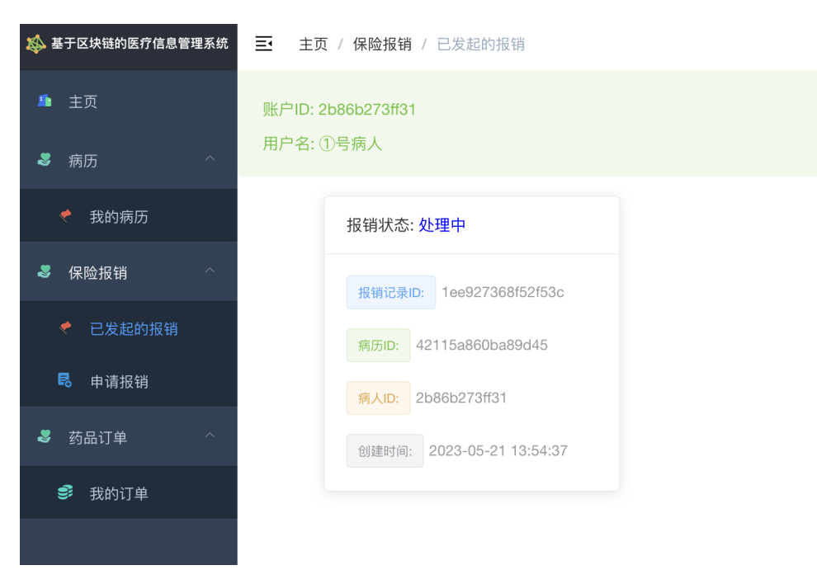
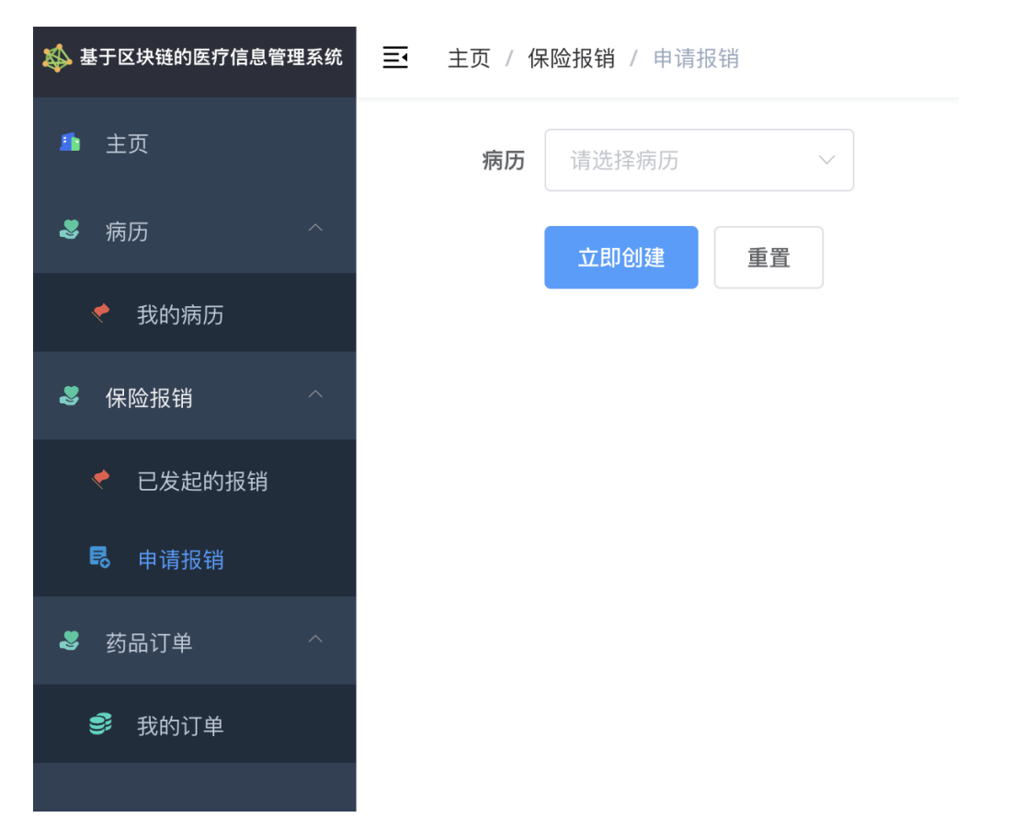
Patient

Slide 23
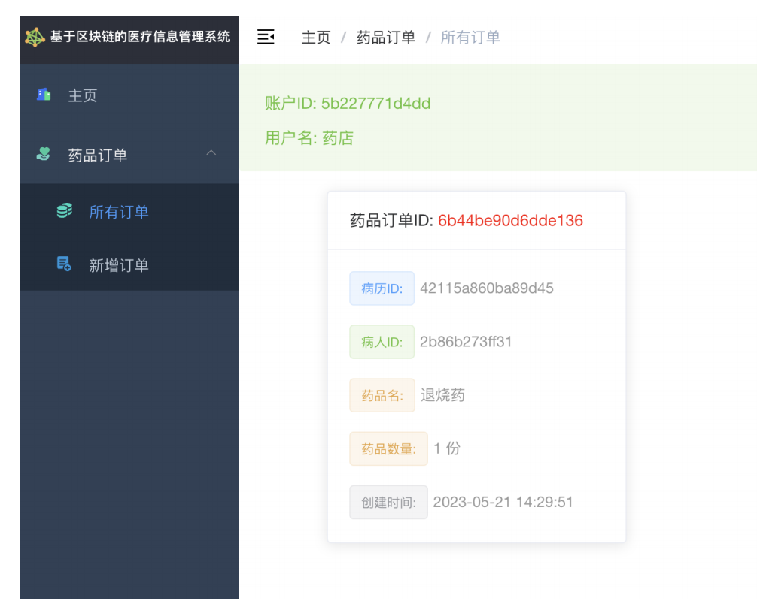
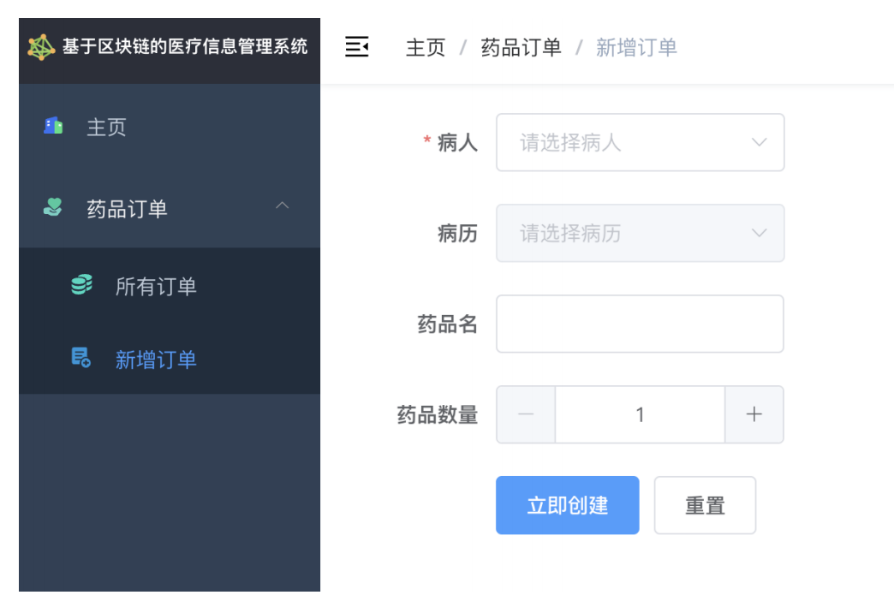
Pharmacy

Slide 24
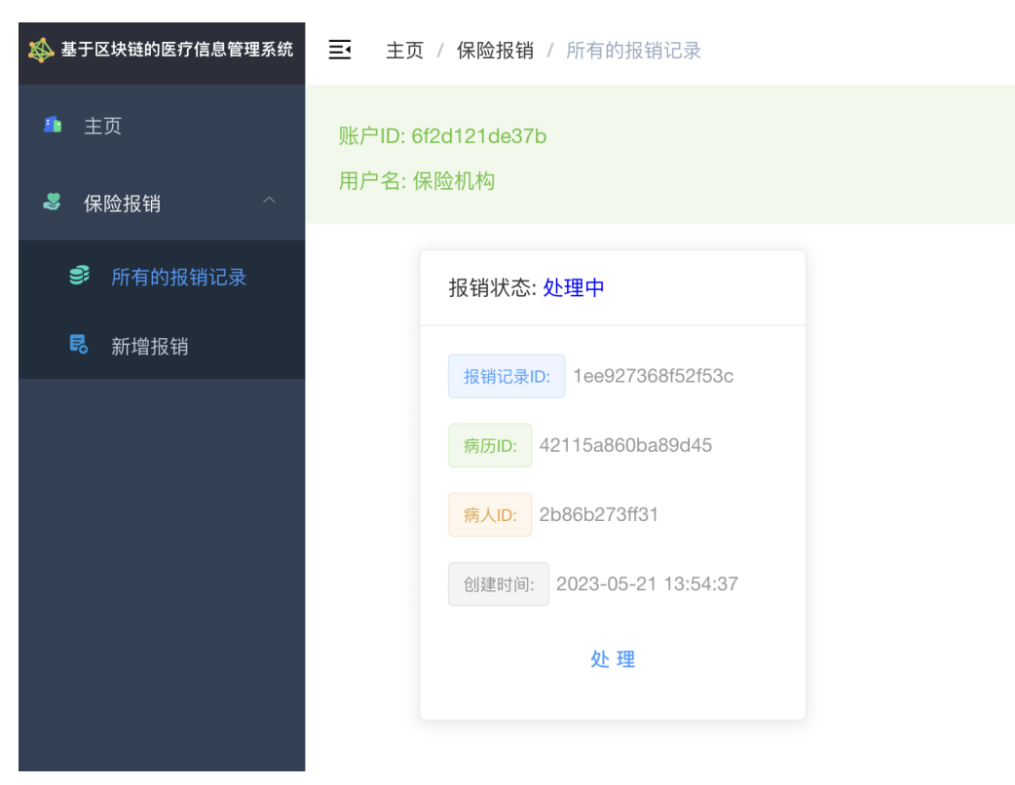
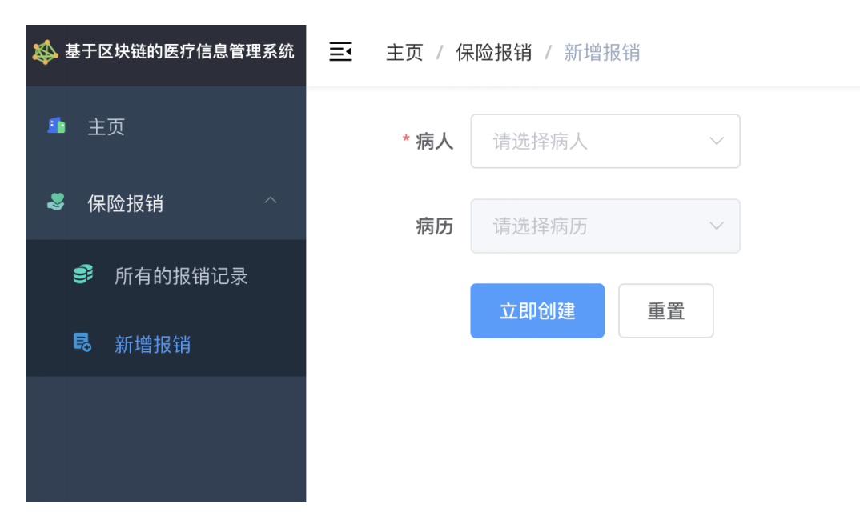
Insurance agency

Slide 25
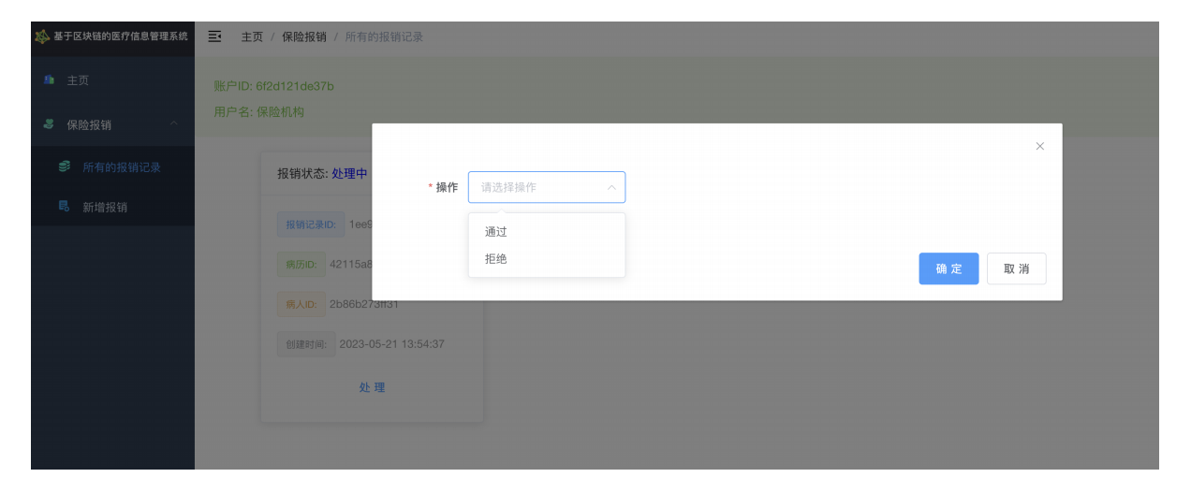
Insurers

Slide 26
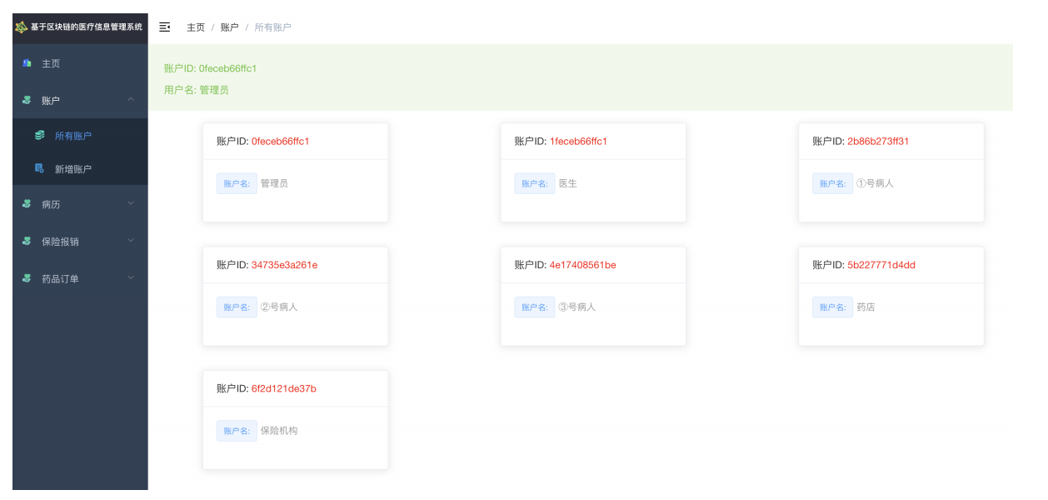
Administrators

Slide 27
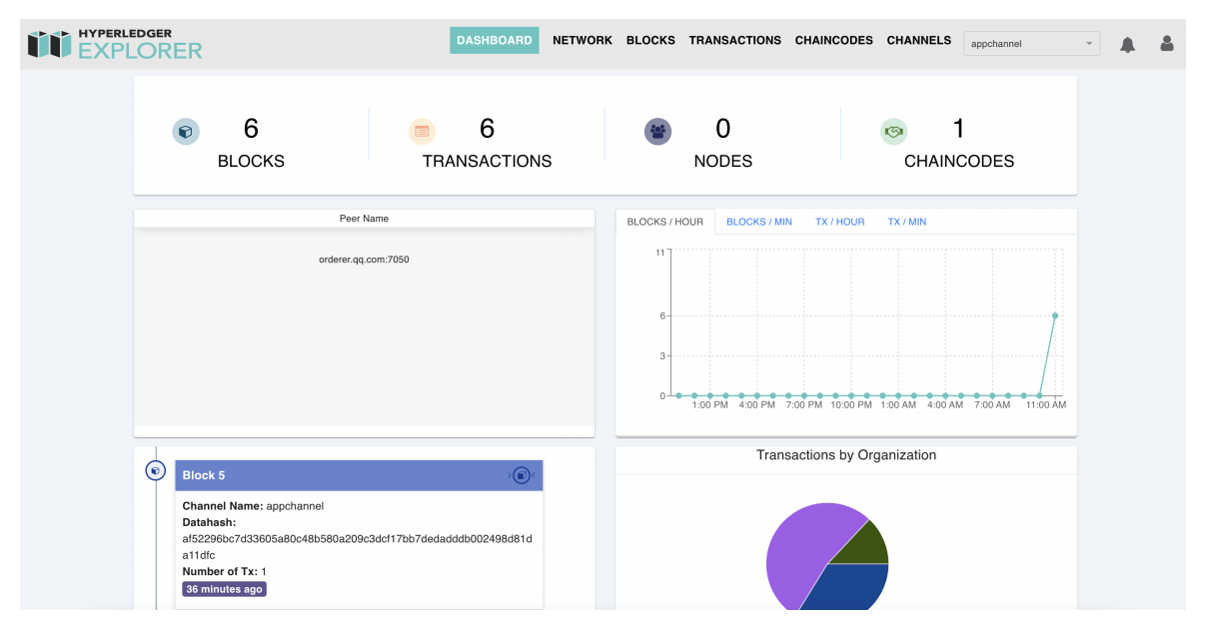
Blockchain Browser
Browsing, querying, and monitoring transactions, blocks, and other information in the network

Slide 28
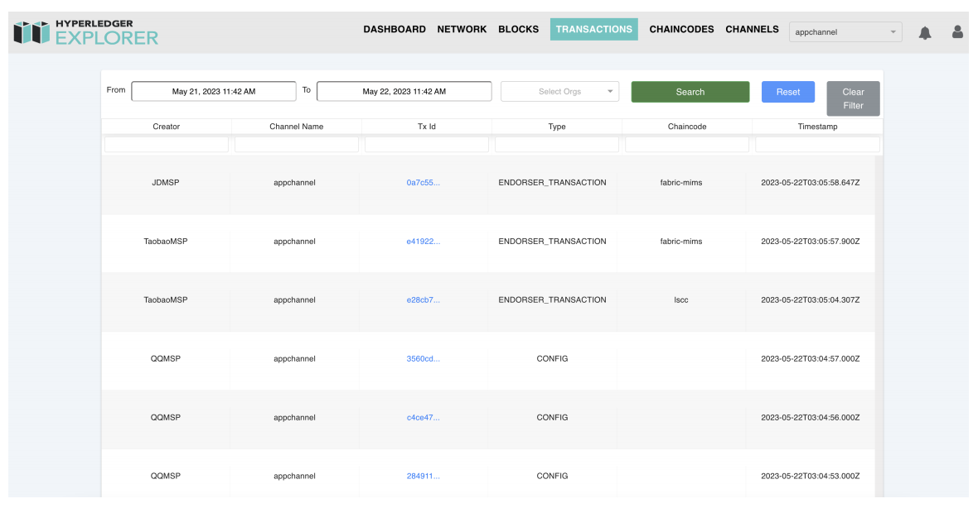
Blockchain Browser

Slide 29
6
Conclusion

Slide 30




System Summary
Functional realization
Data Security
General functions
On chain storage
Easy to share
Role permissions
Consensus mechanism
Prevent tampering
Visualization System
Blockchain Network
Multi user end
Application scenarios
Alliance Chain
Smart contracts
Automatic execution

Slide 31
Reflection and improvement
03
02
More efficient
01
The consensus process and the execution of smart contracts need to be improved to improve efficiency
More confidential
More features
Sacrificing confidentiality for user experience requires other aspects to compensate for it
It needs to be combined with real-life situations
Complex scene improvement function

Slide 32
Practical Significance
Industry Level
Promote the upgrading of the medical industry structure, and assist hospitals, medical insurance, pharmaceuticals and other entities in achieving safe and efficient sharing of medical data
Social Level
Promote the vitality of the reform of the medical and health system, improve the quality of internet healthcare, and increase the sense of medical experience and health autonomy of the people.

Slide 33
Thanks
Group Members: Tang Xinzhe
Wu Yuhan
Shi Xinyi

